Slide 1
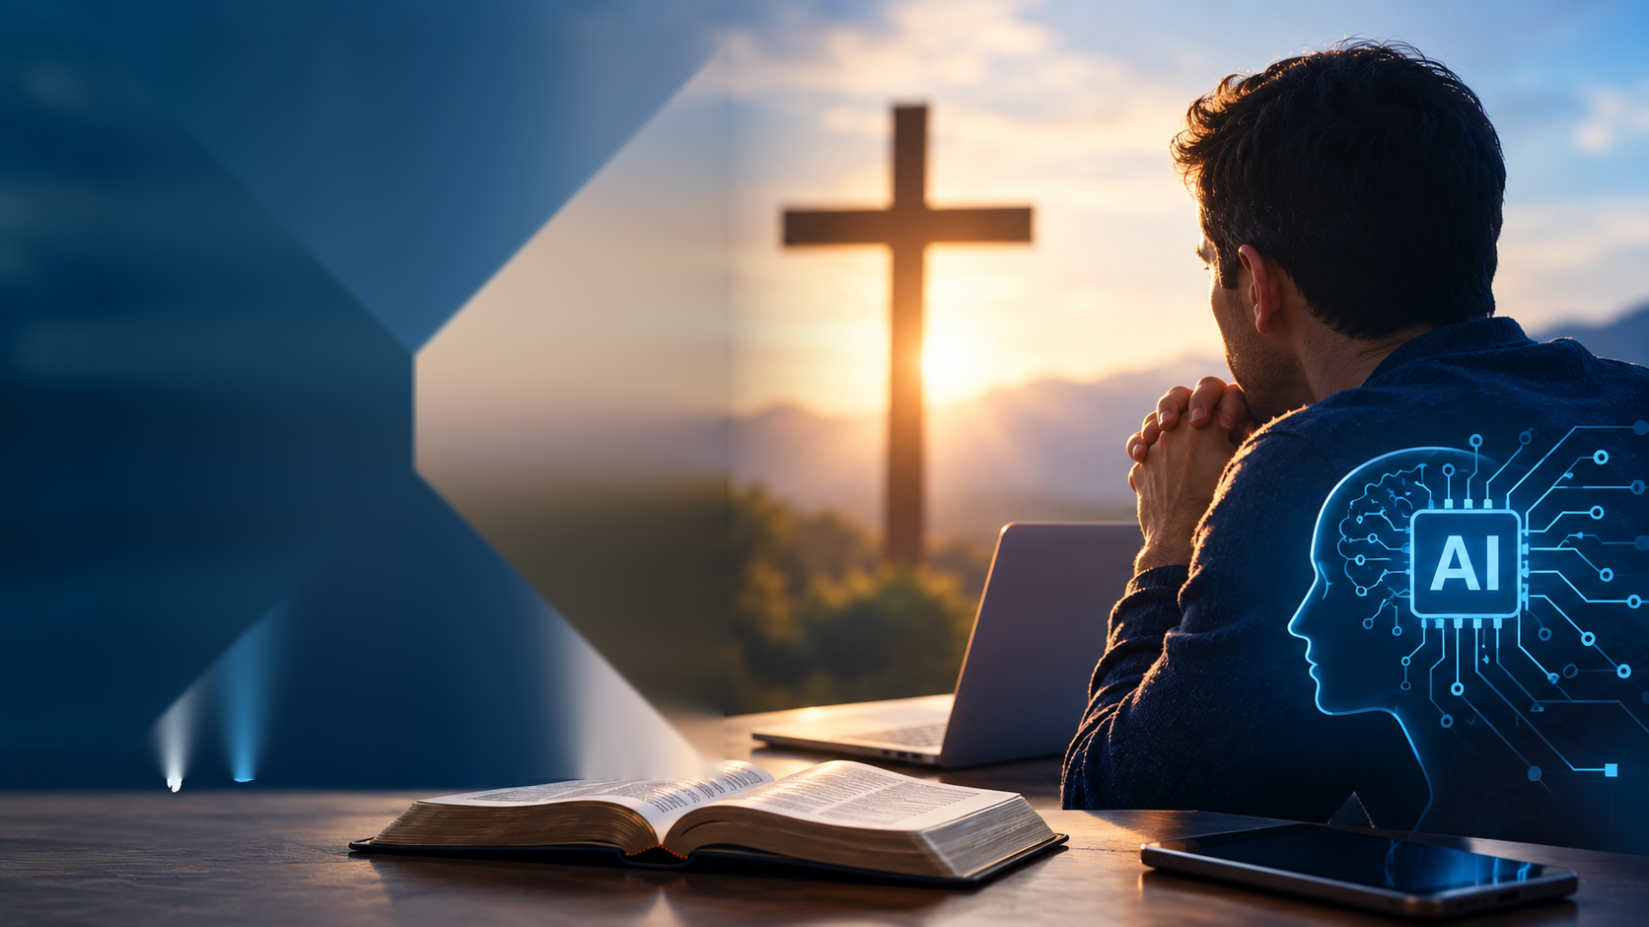

Slide 2
Should
AI
be in
Faith?

Slide 3
Conclusion
AI is a tool that can assist us in our life journey with the Lord.
It takes time and Holy Spirit to know the Father and to do His will.
I will identify the best way to hear God.
We are discipled by inquiring of the Lord.

Slide 4
Why This Message….
/
Artificial Intelligence is here to stay…..
The Church must not allow AI to disciple the Saints!

Slide 5
Some AI Facts from Barna Group
Practicing Christians show openness to AI support, with 48% trusting AI for spiritual growth and 54% trusting it for guidance on purpose or meaning.
Roughly 34% of practicing Christians trust AI spiritual advice as much as the guidance of their human pastors—rising higher among Millennials and Gen Z

Slide 6
More AI Facts from Barna Group
Usage Rates:
  Surveys report that 73% of teens and over one-third of adolescents and young adults (35%) use AI companions.
Preference for AI:
    About 31% of teens find conversations with AI as satisfying—or more satisfying—than interactions with real friends, and 60% of AI companion users feel more comfortable sharing deep problems with a bot than with real-world family or friends.
Romantic and First Connections:
  Recent secular data indicates that nearly 1 in 5 teens report that they or a peer have had a romantic relationship with an AI chatbot.

Slide 7
Theological Concerns and Cautions
The Illusion of All-Knowing Truth:
  Large language models can act as "fake all-knowing" authorities, tempting users to replace divine truth with algorithmic output prone to bias or errors.
Loss of Human Connection:
  AI cannot experience the Holy Spirit, feel genuine empathy, or substitute for real-world Christian community and pastoral counseling.

Slide 8

Read and Study the Bible
God’s Word to You

Slide 9
Matthew 22:29
Jesus replied, “You are in error because you do not know the Scriptures or the power of God.”

Slide 10
John 2:17
His disciples remembered that it is written: “Zeal for your house will consume me.”

Slide 11
Matthew 4:4
Jesus answered, “It is written: ‘Man shall not live on bread alone, but on every word that comes from the mouth of God.’”

Slide 12

Inquire of the Lord
Seek God’s guidance before you act.
Let His word shape your decisions.

Slide 13
Jeremiah 10:21
The shepherds are senseless
and do not inquire of the Lord;
so they do not prosper
and all their flock is scattered.

Slide 14
GOD’s AI
A lways
I nquiring
Grace Book not Facebook
Know The BIBLE
Read it Daily
Pray and Inquire of the Lord
Ask to hear what the Father is saying and do only that

Slide 15

Practice
God’s AI
Lectio Divina
Proverbs 3:5-10

Slide 16
Lectio Divina
Proverbs 3:5-10
Read 3 Times:
Trust in the Lord with all your heart
and lean not on your own understanding;
⁶ in all your ways submit to him,
and he will make your paths straight.
⁷ Do not be wise in your own eyes;
fear the Lord and shun evil.
⁸ This will bring health to your body
and nourishment to your bones.
⁹ Honor the Lord with your wealth,
with the firstfruits of all your crops;
¹⁰ then your barns will be filled to overflowing,
and your vats will brim over with new wine.
1. General Impression
2. Word or phrase that stands out.
3. What is Father saying right now?

Slide 17
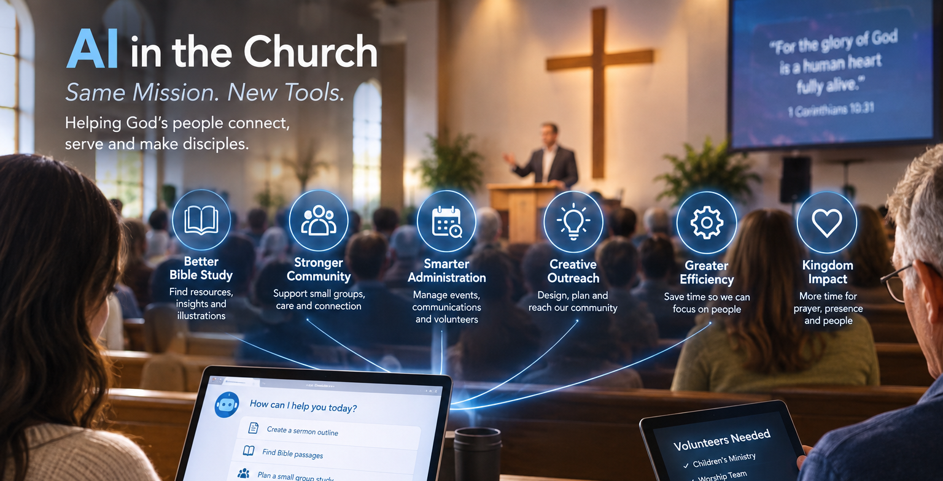

Slide 18
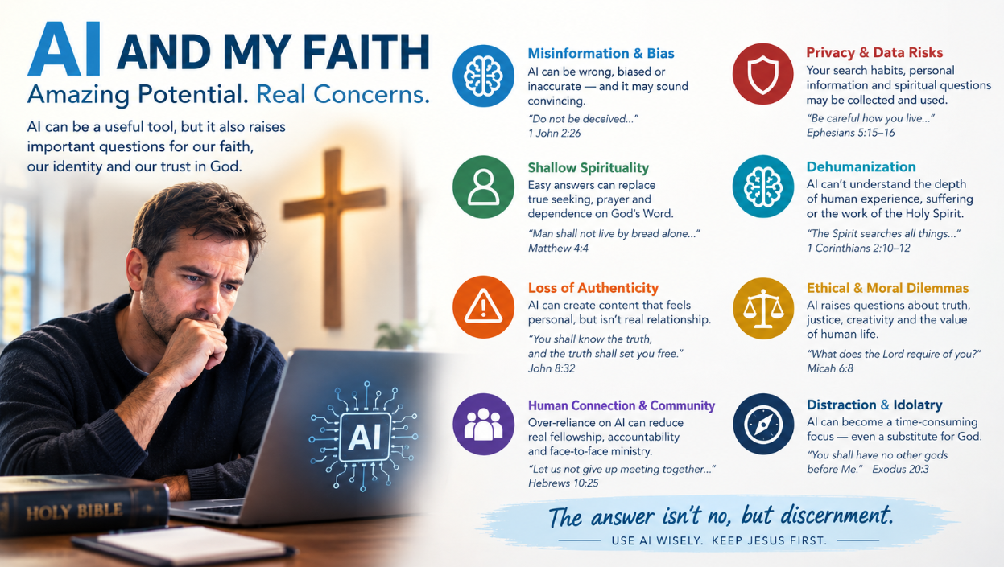

Slide 19
Conclusion
AI is a tool that can assist us in our life journey with the Lord.
It takes time and Holy Spirit to know the Father and to do His will.
We are discipled by inquiring of the Lord.
We must practice God’s AI through reading and studying the Bible.

