Slide 1
COMMUNITY
🫶🏻🫶🏼🫶🏽🫶🏾🫶🏿

Slide 2
“If you want to go fast, go alone,
but if you want to go far, go together.”

Slide 3
ACTS 2:42-47
And they devoted themselves to the apostles' teaching and the KOINONIA, to the breaking of bread and the prayers. And awe came upon every soul, and many wonders and signs were being done through the apostles. And all who believed were together and had all things in common. And they were selling their possessions and belongings and distributing the proceeds to all, as any had need. And day by day, attending the temple together and breaking bread in their homes, they received their food with glad and generous hearts, praising God and having favor with all the people. And the Lord added to their number day by day those who were being saved.

Slide 4
koinónia
partnership, contributory help, participation, sharing in common, communion, a fellowship in the spirit.

Slide 5
ACTS 4:32-37
Now the full number of those who believed were of one heart and soul, and no one said that any of the things that belonged to him was his own, but they had everything in common. And with great power the apostles were giving their testimony to the resurrection of the Lord Jesus, and great grace was upon them all. There was not a needy person among them, for as many as were owners of lands or houses sold them and brought the proceeds of what was sold and laid it at the apostles' feet, and it was distributed to each as any had need. Thus Joseph, who was also called by the apostles Barnabas (which means son of encouragement), a Levite, a native of Cyprus, sold a field that belonged to him and brought the money and laid it at the apostles' feet.

Slide 6
The church engages in koinonia after the coming of the Holy Spirit because the Holy Spirit is the agent of unity and shared experience, fostering a sense of belonging and shared purpose among believers, as seen in the early church's practice of sharing possessions and living in unity. —- GOOGLE AI
What effect did true koinonia have on those who were watching them - and who were not yet believers in Christ (v. 47)? JOHN 13:35

Slide 7
DISCUSS:
How does the word ‘Koinonia’ and all it means make you feel?
What’s an ingredient of community that you personally struggle with?
What’s an ingredient that you feel you do well?
Pick a ingredient off the list and share how you will apply it this week.

Slide 9
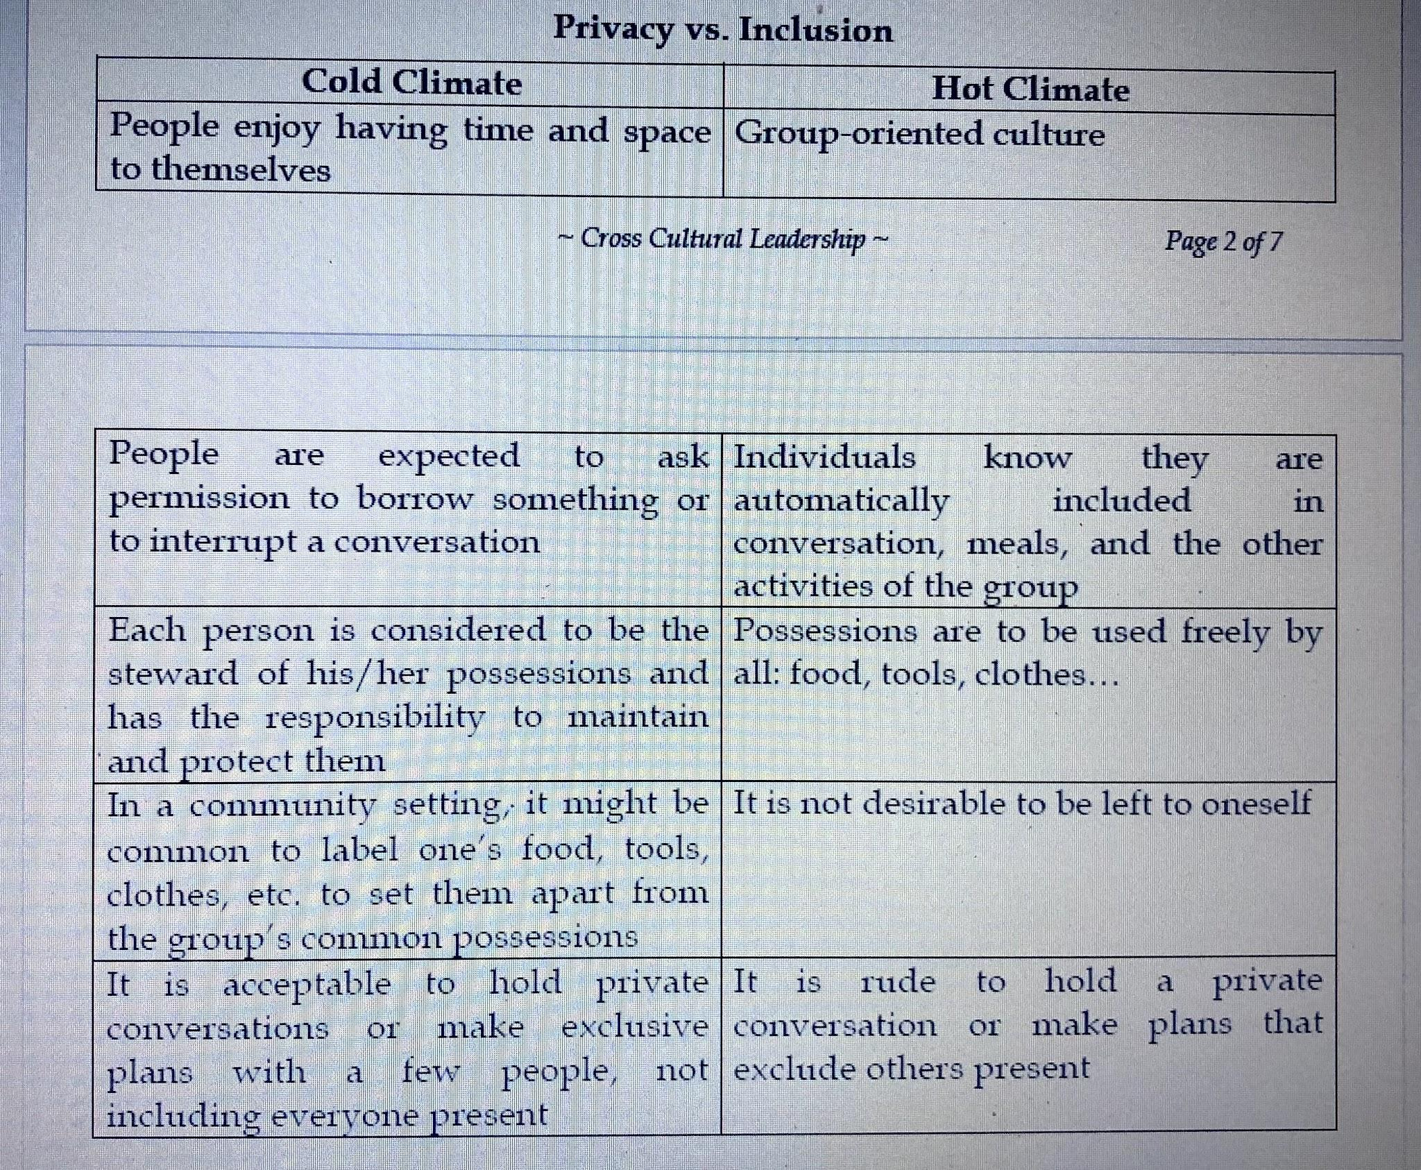

Slide 16
