Slide 1
The Leaven of the Pharisees
And some other stuff

Slide 2
The leaven of the Pharisees
Bad Belief Systems
Some of the ways that the culture influences our thinking
Talk about this in the context of relationships
Power, Freedom, and Control

Slide 3
The leaven of the Pharisees – comic relief
Matthew 16:1-13
And the disciples came to the other side (of the Lake) and had forgotten to take bread….
Watch out for the leaven of the Pharisees.
And they began to discuss among themselves, saying “It is because we took no bread”

Slide 4
The leaven of the Pharisees
What is he saying?
Think about what you think, and who you listen to
  Romans 12:2
  Do not conform to the pattern of this world, but be transformed by the renewing of your mind. Then you will be able to test and approve what God’s will is—his good, pleasing and perfect will.

Slide 5
The Leaven of the Pharisees
Romans 8:5-8
Those who live according to the flesh have their minds set on what the flesh desires; but those who live in accordance with the Spirit have their minds set on what the Spirit desires. ⁶ The mind governed by the flesh is death, but the mind governed by the Spirit is life and peace. ⁷ The mind governed by the flesh is hostile to God; it does not submit to God’s law, nor can it do so. ⁸ Those who are in the realm of the flesh cannot please God

Slide 6
So how is this relevant to me?
The Pharisees were the arbiters of Jewish religion, and shaped the Jewish culture
Who are today’s Pharisees?
What is the culture that they are shaping?

Slide 7
So how is this relevant to me?
Galatians 5:7-10
You were running a good race. Who cut in on you to keep you from obeying the truth? That kind of persuasion does not come from the one who calls you. “A little yeast works through the whole batch of dough.” I am confident in the Lord that you will take no other view. The one who is throwing you into confusion, whoever that may be, will have to pay the penalty.

Slide 8
The leaven of the Pharisees today?
The cultural messages that we get
The modern, progressive culture insists on the world of what “should be” rather than the world that is. A world without God, and without Satan
  Assumes that people are fundamentally good (just misunderstood)
  Your “truth” is how you feel (not the word of God)
  Says pain and suffering is something that must be avoided at all costs
  Everything is about power, and people’s drive to get it.
This is the leaven of the Pharisees today
This is a Bad B.S.

Slide 9
Relationships: Power, Freedom and Control
Getting rid of Bad B.S. in our relationships
Chucking out the leaven of the Pharisees – the bad messages from our culture
Healing how we think about ourselves and others
Start with Power.

Slide 10
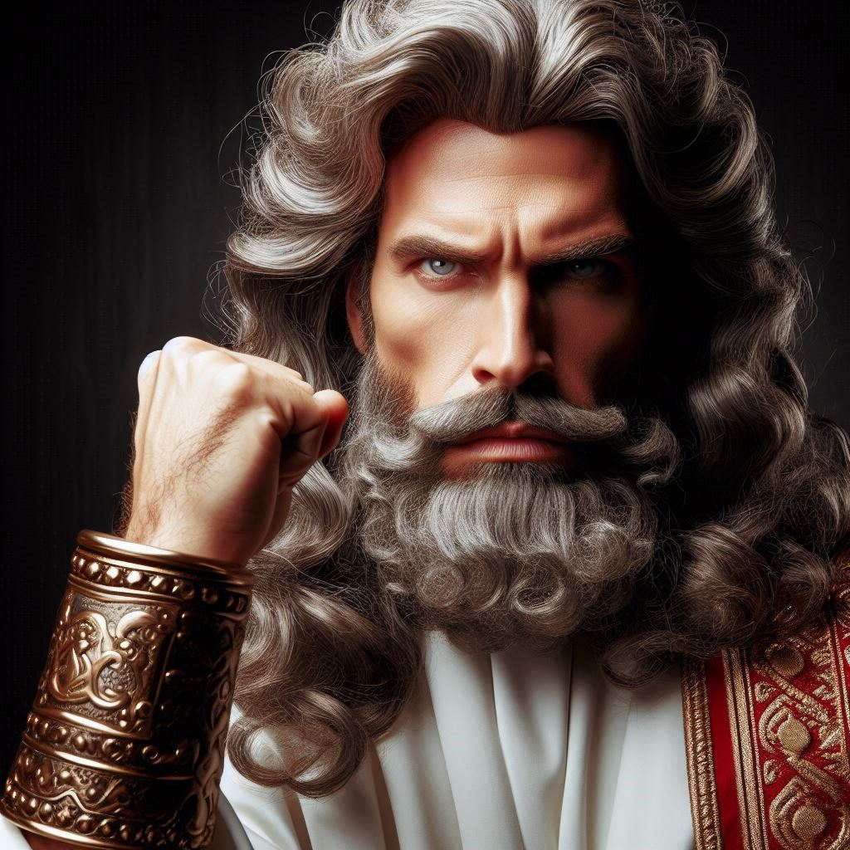
Power – Not this:

Slide 11
Power
2 Timothy 1:7
  For God has not given them a spirit of fear, but of power and of love and of a sound mind.” (NKJV)
  For the spirit that God has given us does not make us timid, instead his spirit fills us with power, love, and self control. (NASB)
  For God has not given us a spirit of timidity, but of power and love and discipline (Good News Translation)
Notice timidity or fear is contrasted with power, love and discipline

Slide 12
What did PAUL mean by Power?
What is a powerful person
  Take responsibility for today
  Create the tomorrow they want to live in
  Your relationships happen from the inside out
  You are not afraid to say what you feel, or what you need
  Make decisions, direct their own life and vision, because the have a “sound mind” that gives them the ability to manage themselves.

Slide 13
The result of powerlessness - Control
The result of seeing yourself as powerless
Life happens to you
You are a victim
Life scares you, as do other people.
You live in a perpetual state of anxiety and fear.
To feel safe you CONTROL other people
Power is the antidote to fear, anxiety and control

Slide 14
the opposite of control IS FREEDOM
Power gives you the freedom to be you
Power let’s you let your partner be them
This is the right belief system, two powerful people in a relationship do not have to control
When you are free, you have the freedom to make choices to control your own behaviour in order to increase their partner’s happiness
For God has not given them a spirit of fear, but of power and of love and of a sound mind.”

Slide 15
PRACTICAL APPLICATION – the tea towels
POWER over yourself
RELEASES you from FEAR
Then you have FREEDOM to make your own choices
You can CHOOSE FREELY to behave in a way the SERVES OTHERS
POWER = FREEDOM = CHOICE = LOVE
THE TEA TOWELS

Slide 16
So what now
We are all works in progress – Ephesians 4:22-24
Fight bad belief systems, understand how God sees you, and how God can help you
  – 2 Timothy 1:7, Colossians 2:10
Work on becoming a powerful person in yourself (Romans 8:29)
Work on becoming a powerful person in your relationships (Philippians 2: 3-4, Ephesians 4:3, Colossians 2:10)
Then in your absolute freedom, choose to submit to the needs of your partner (Romans 8:2)
Where the spirit of God is, there is freedom
And …………………..

Slide 17
Fold the Tea Towels Properly
(book of Leonor, Chapter 1, verses 1-6)
Fold in Half Lengthwise: Fold the towel half lengthwise.
Fold into Thirds: Fold the towel into thirds lengthwise, creating a long, narrow shape.
Fold into Thirds Again
Finally, fold the towel into thirds or quarters, to create a compact, upright rectangle.
Put it away carefully in the proper drawer, back right corner, aligned with the rest
Close the drawer (using the handle).

