Slide 1
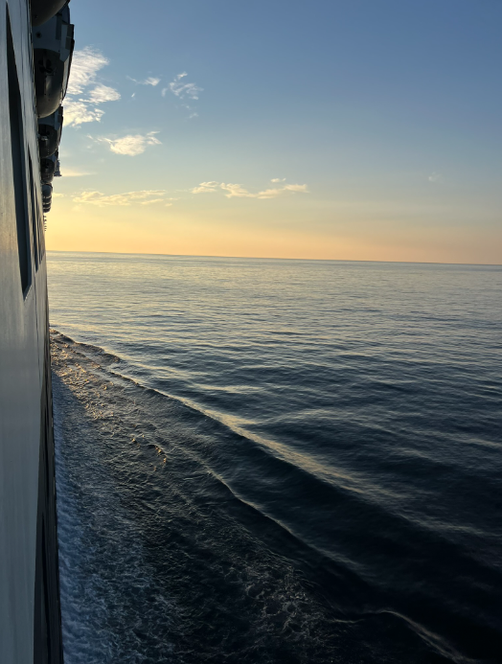
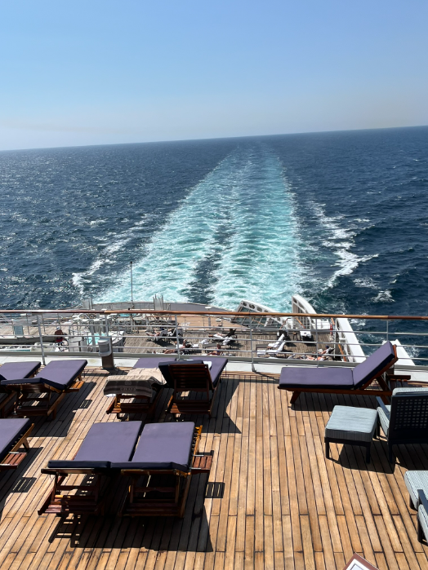
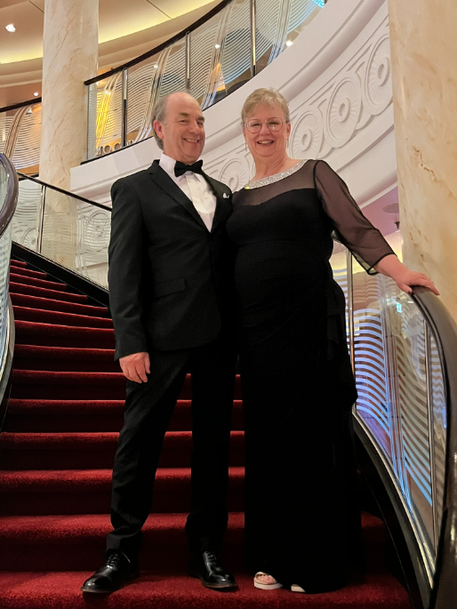
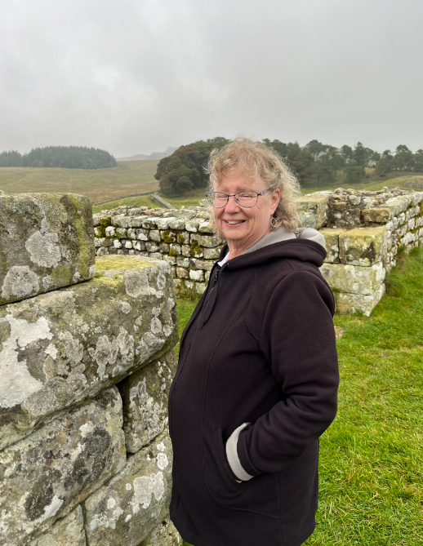
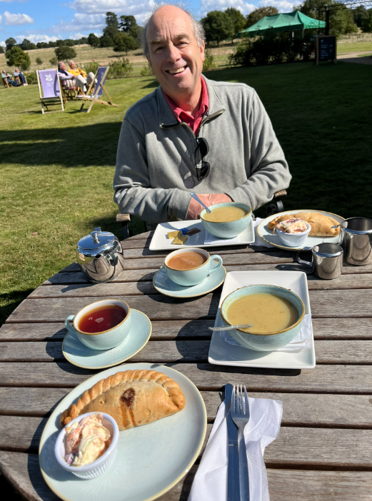

Slide 2
Our Prayer Journey
Experiencing Prayer on The Journey

Slide 3
Conclusion
When we understand prayer as ‘keeping company with God’ through all aspects of life we live a 24/7 journey in His Presence
Our UK trip encouraged us in prayer:
Father is always listening
It is His pleasure to listen and reply
Don’t misunderstand prayer

Slide 4
Psalm 107
¹ Give thanks to the Lord, for he is good; his love endures forever.
² Let the redeemed of the Lord tell their story—
⁸ Let them give thanks to the Lord for his unfailing love and his wonderful deeds for mankind, ⁹ for he satisfies the thirsty and fills the hungry with good things.

Slide 5
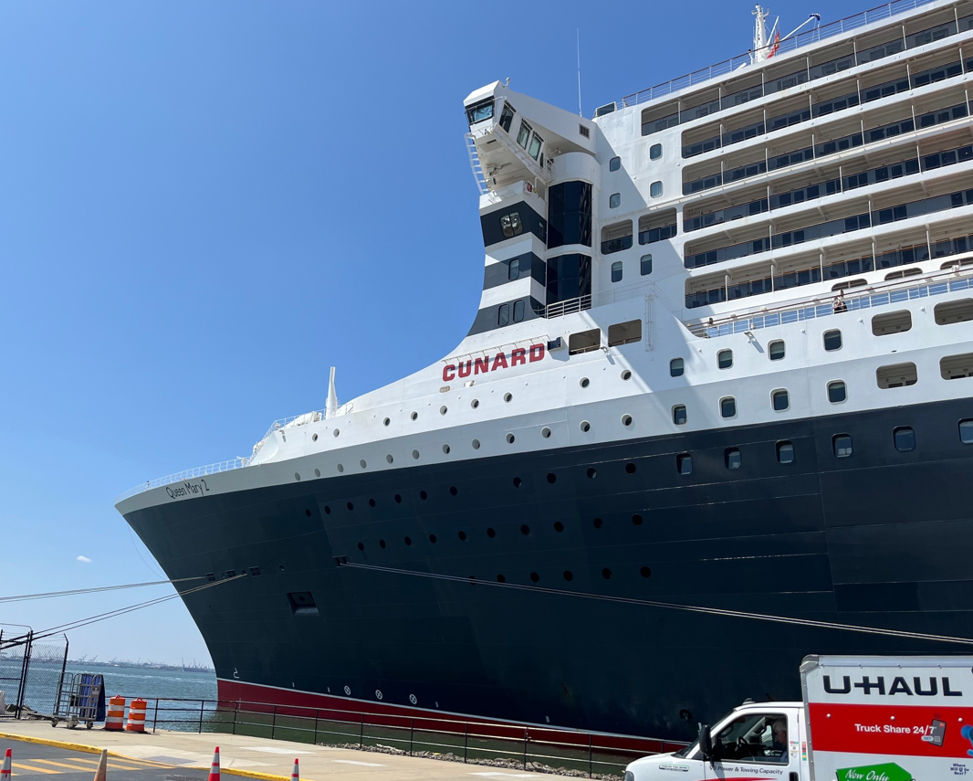
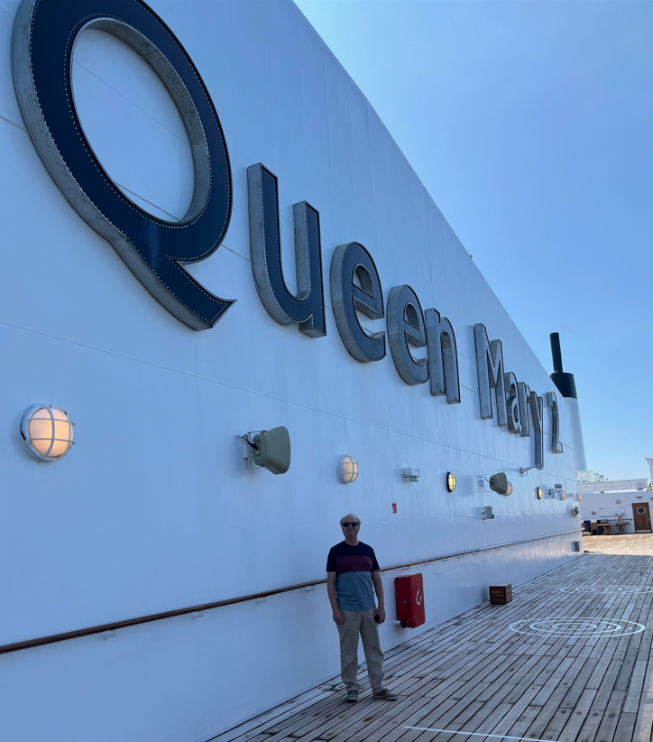

Slide 6
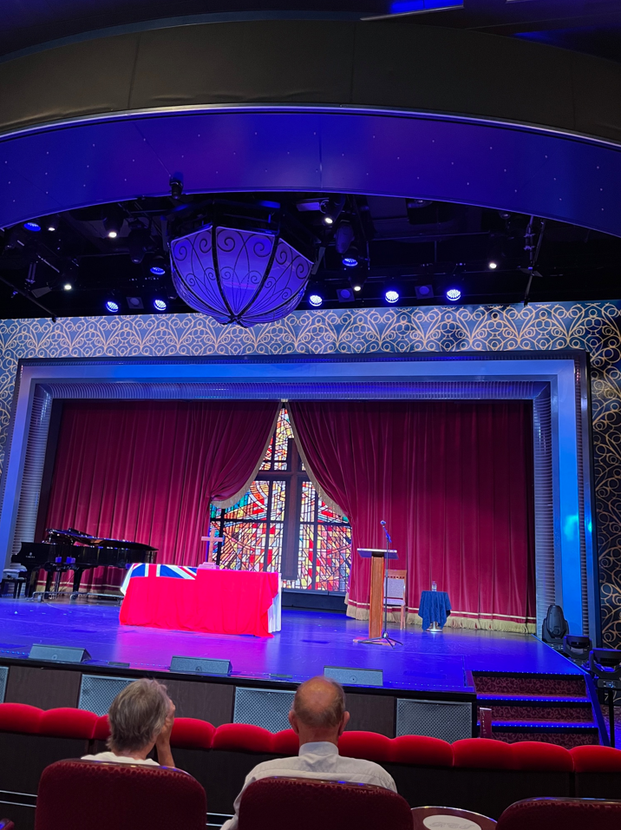
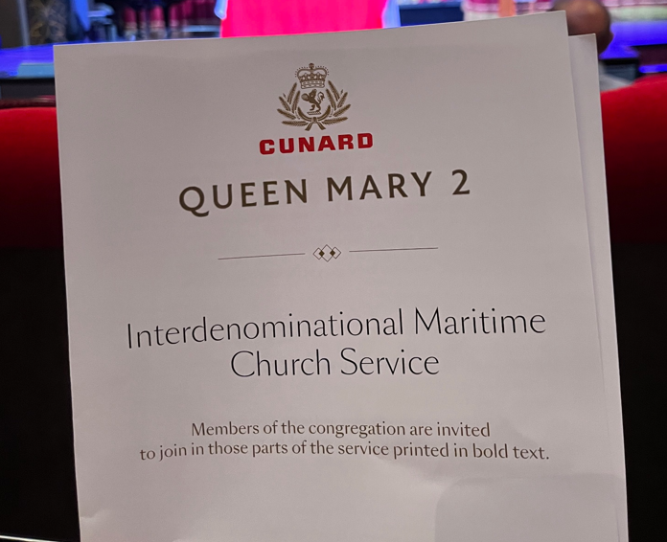
Church Service onboard Queen Mary 2

Slide 7
Isaiah 41:13
For I am the Lord your God who takes hold of your right hand and says to you, Do not fear; I will help you.

Slide 8
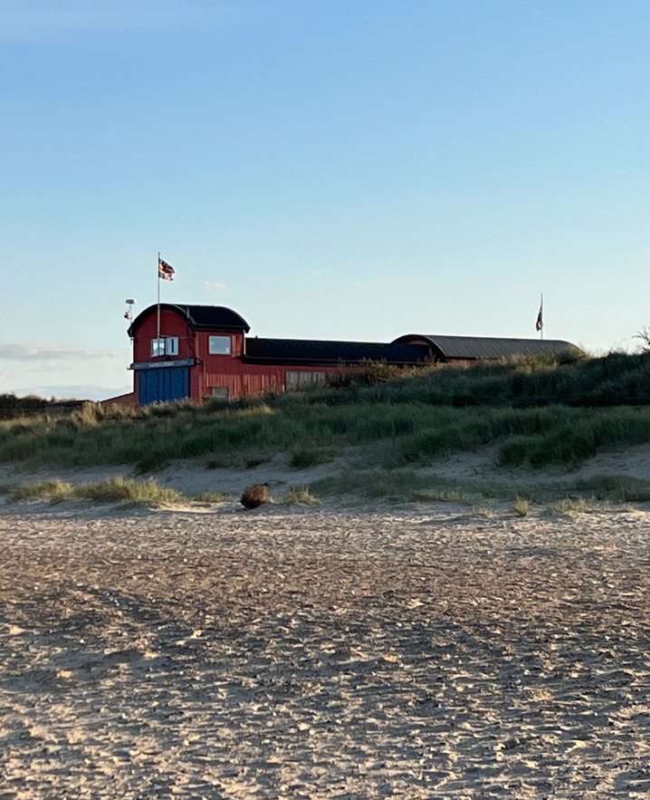
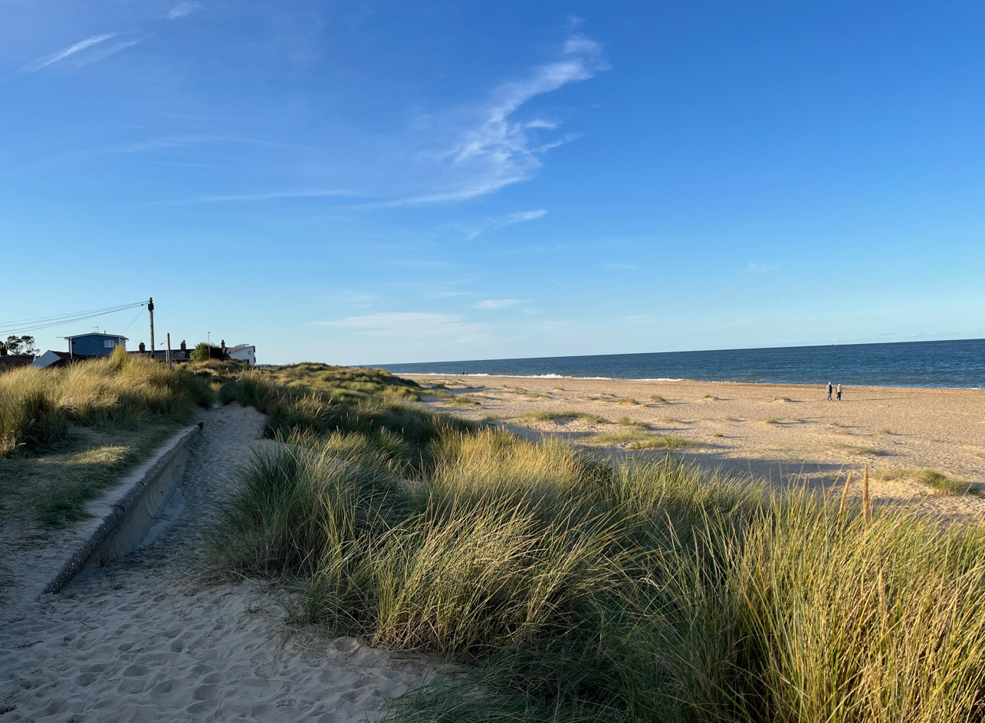

Slide 9
Philippians 4:6-7
⁶ Do not be anxious about anything, but in every situation, by prayer and petition, with thanksgiving, present your requests to God.
⁷ And the peace of God, which transcends all understanding, will guard your hearts and your minds in Christ Jesus.

Slide 10
1 John 5:14-15
¹⁴ This is the confidence we have in approaching God: that if we ask anything according to his will, he hears us.
¹⁵ And if we know that he hears us—whatever we ask—we know that we have what we asked of him.

Slide 11
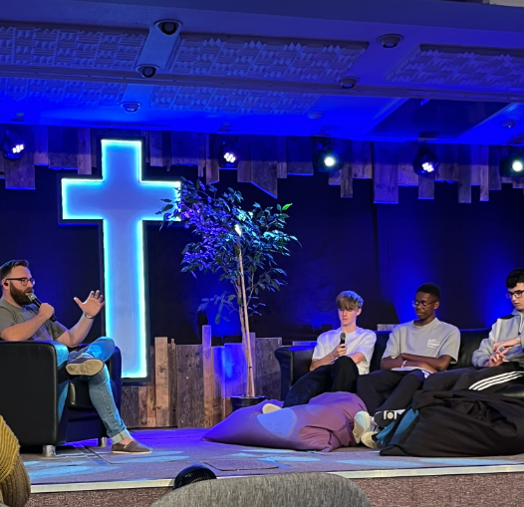
Youth sharing their experiences from summer camp

Slide 12
Don’t Misunderstand Prayer
Prayer is Not:
Wishful-thinking Prayer
Head-in-the-sand Prayer
Magic-Genie Prayer
Demanding-my-rights Prayer
Prayer is walking with your Father
A Relationship, not a Religion

Slide 13
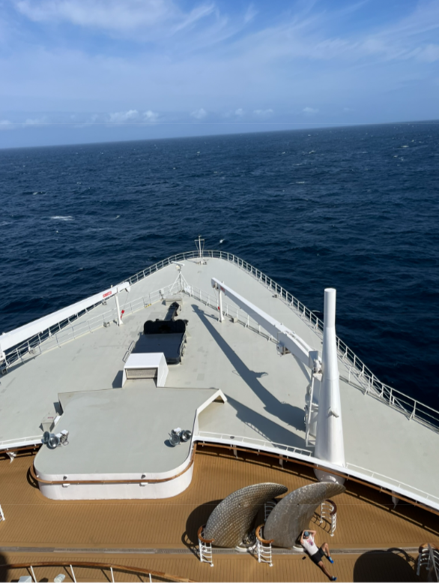
Enjoy the Journey ahead
Knowing the presence of God!
Develop your conversation with Father.
Prayer is talking, listening and waiting…….

