Slide 1
Identity In Christ
Week #1: Identifying the lies we’ve believed about identity
Week #2: Christ is the foundation of our identity
Week #3: Hearing God’s voice about identity
Week #4: Helping others find their identity in Christ

Slide 2
Ephesians 1:16-18
I do not cease to give thanks for you, remembering you in my prayers, that the God of our Lord Jesus Christ, the Father of glory, may give you a spirit of wisdom and of revelation in the knowledge of him, having the eyes of your hearts enlightened, that you may know what is the hope to which He has called you.

Slide 3
What is the hope to which He has called us?
Romans 8:28-30
And we have known that for those who love God all things do work
together for good, to those who are called according to His purpose;
because whom He did foreknow, He also predestined to be conformed into the image of His Son, that he might be first-born among many brethren; and whom He predestined, these also He did call; and whom He did call, these also He declared righteous; and whom He declared righteous, these also He did glorify.

Slide 4
Who Do You Say I Am?
Matthew 16:13-18
Now when Jesus came into the district of Caesarea Philippi, he asked his disciples, “Who do people say that the Son of Man is?” And they said, “Some say John the Baptist, others say Elijah, and others Jeremiah or one of the prophets.” He said to them, “But who do you say that I am?” Simon Peter replied, “You are the Christ, the Son of the living God.” And Jesus answered him, “Blessed are you, Simon Bar-Jonah! For flesh and blood has not revealed this to you, but my Father who is in heaven. And I tell you, you are Peter, and on this rock I will build my church, and the gates of hell shall not prevail against it. I will give you the keys of the kingdom of heaven, and whatever you bind on earth shall be bound in heaven, and whatever you loose on earth shall be loosed in heaven.”

Slide 5
Revelation (apokálypsis a disclosure of truth, instruction, concerning divine things before unknown — especially those relating to the Christian salvation — given to the soul by God himself, or by the ascended Christ, especially through the operation of the Holy Spirit
Knowledge (gnosis- a feminine noun derived from 1097 /ginṓskō, "experientially know" – functional ("working") knowledge gleaned from first-hand (personal) experience, connecting theory to application; "application-knowledge," gained in (by) a direct relationship.)
Transformation metamorphóō (from 3326 /metá, "change after being with" and 3445 /morphóō, "changing form in keeping with inner reality") – properly, transformed after being with; transfigured.

Slide 6
Who Is the Christ we are being transformed into the image of?
Colossians 1:15-20:
He is the image of the invisible God, the firstborn of all creation. For by Him all things were created, in heaven and on earth, visible and invisible, whether thrones or dominions or rulers or authorities—all things were created through Him and for Him. And He is before all things, and in Him all things hold together. And He is the head of the body, the church. He is the beginning, the firstborn from the dead, that in everything He might be preeminent. For in Him all the fullness of God was pleased to dwell, and through Him to reconcile to Himself all things, whether on earth or in heaven, making peace by the blood of His cross.

Slide 7
BEHOLD
2 Corinthians 3:16-18
But when one turns to the Lord, the veil is removed. Now the Lord is the Spirit, and where the Spirit of the Lord is, there is freedom. And we all, with unveiled face, beholding the glory of the Lord, are being transformed into the same image from one degree of glory to another. For this comes from the Lord who is the Spirit.

Slide 8
1 Cor 13:12
For now we see only a reflection as in a mirror; then we shall see
face to face. Now I know in part; then I shall know fully, even as I
am fully known.
1 John 3:2-3
Beloved, we are God’s children now, and what we will be has not yet appeared; but we know that when he appears we shall be like him, because we shall see him as he is. And everyone who thus hopes in him purifies himself as he is pure.

Slide 9
2 Corinthians 4:4-6
In their case the god of this world has blinded the minds of the unbelievers, to keep them from seeing the light of the gospel of the glory of Christ, who is the image of God. For God, who said, “Let light shine out of darkness,” has shone in our hearts to give the light of the knowledge of the glory of God in the face of Jesus Christ.
John 1:14
And the Word was made flesh, and dwelt among us, (and we beheld His glory, the glory as of the only begotten Father,) full of grace and truth.

Slide 10
What is glory?
1391 dóksa "what evokes good opinion, i.e. that something has inherent, intrinsic worth. It corresponds to the OT word, kabo (OT 3519, "to be heavy"). Both terms convey God's infinite, intrinsic worth (substance, essence). WOW
Beholding in Jesus the glory of the Father, we learn to obey, love, and know Him. By daily beholding Him, who came as a Light into the world, we are more and more freed from the darkness of ignorance, error, sin, and misery; we learn that the command of God is everlasting life, which is to know, to intimately experience, and to be transformed and changed into the likeness and image of the Messiah, the Chosen and Anointed One, the Son of the Living God.

Slide 11
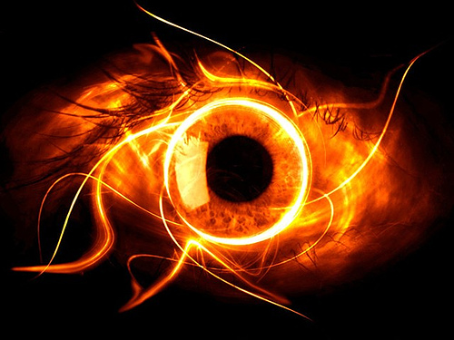
Job 37
Ezekiel 1
Daniel 7:8-14
BEHOLD
Revelation 1:4-8, 12-20
Revelation 19:11-116

