Slide 1
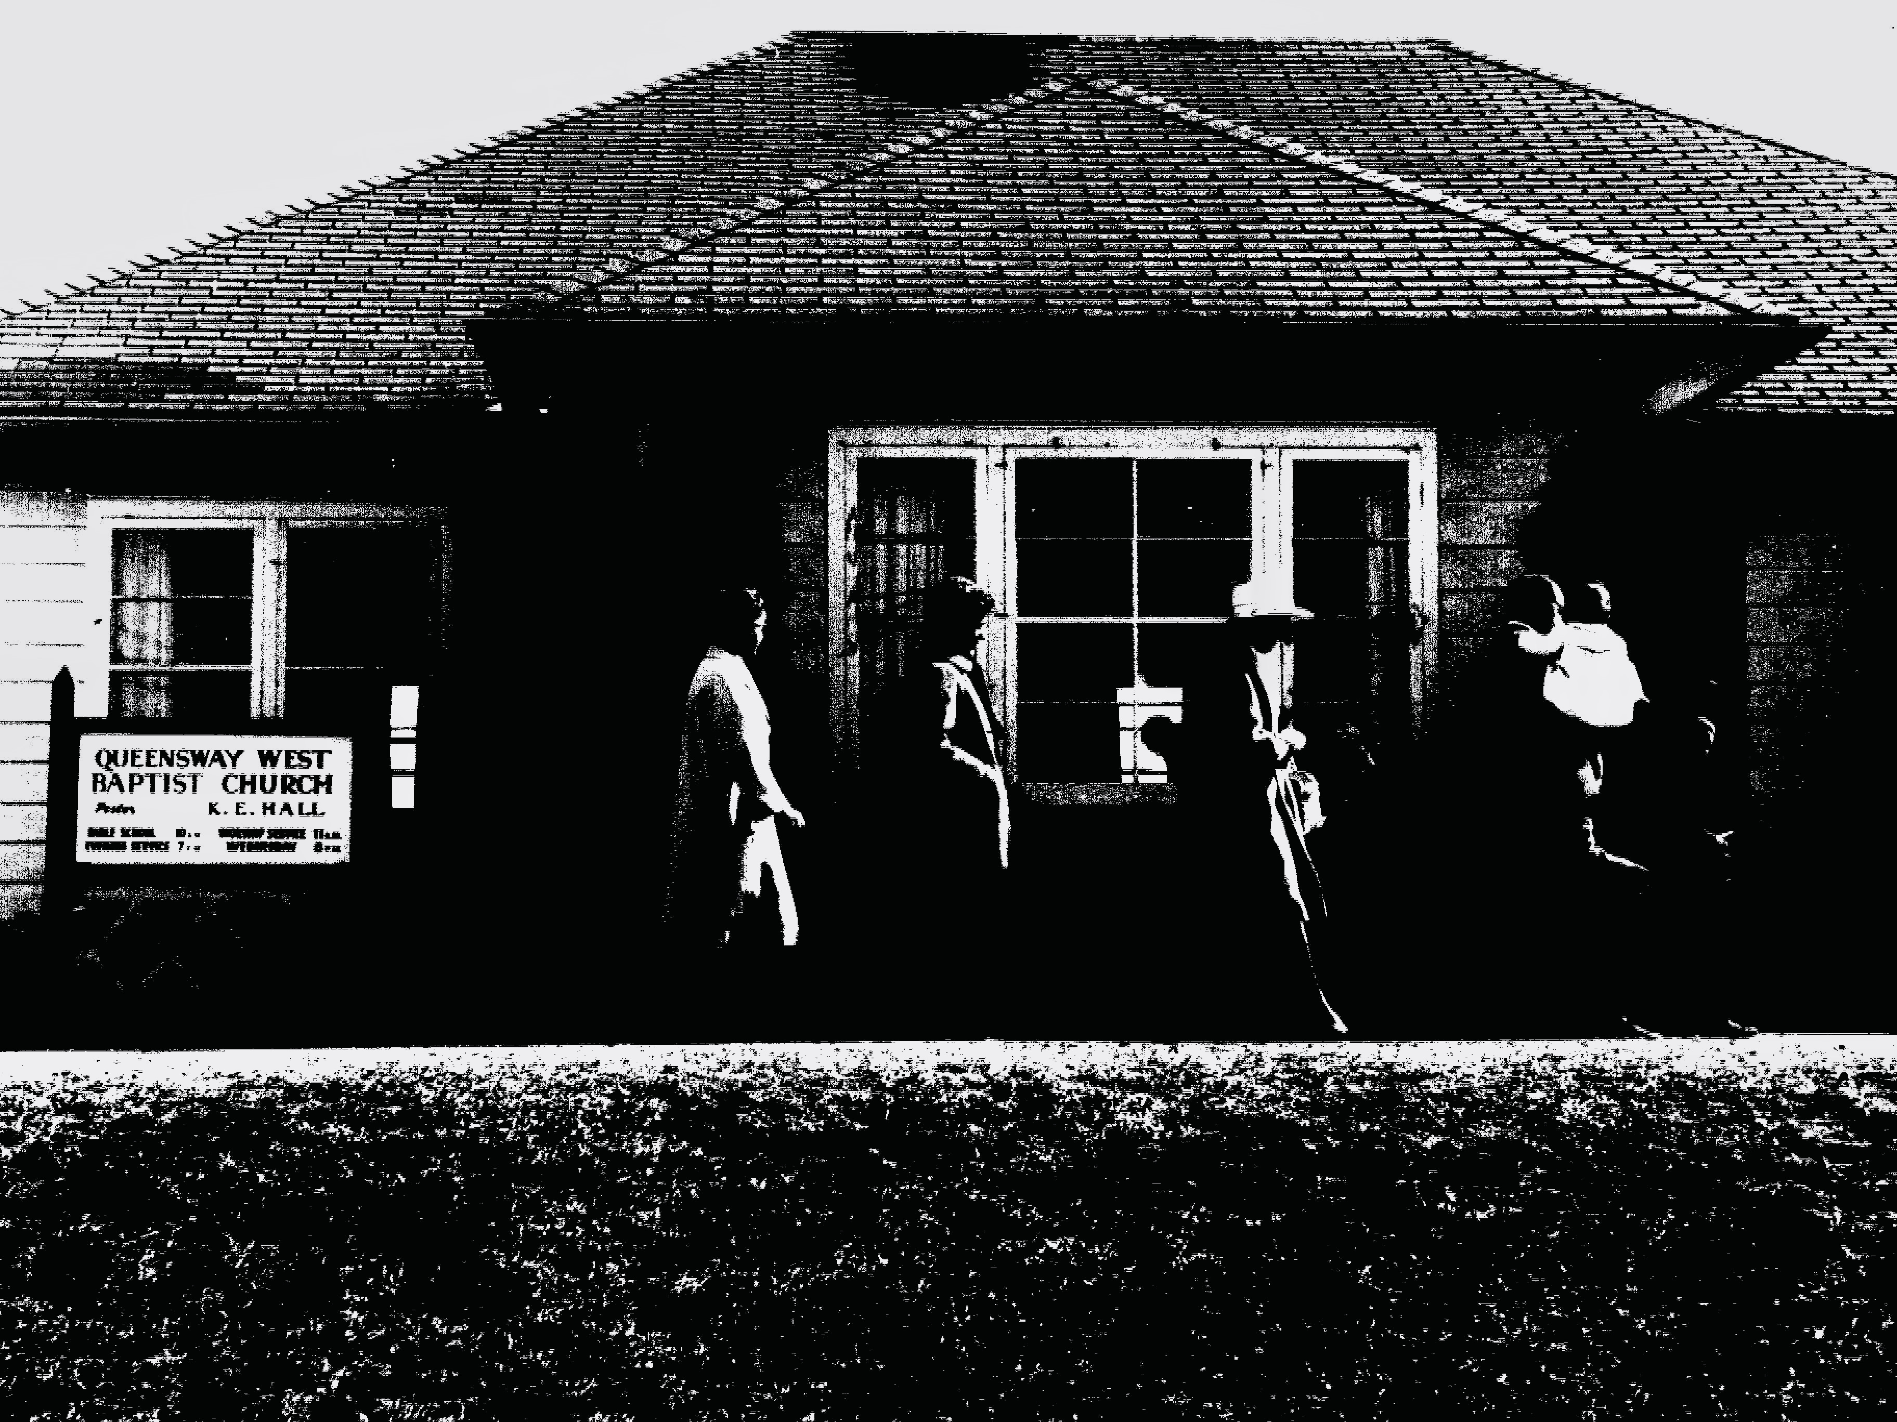
1311 Pinecrest Rd. 1967

Slide 2
In 1965, I (Pastor Ken Hall) was graduating from seminary and Lois and I were engaged and planned to be married in July. Queensway West Baptist Church called me to come to be the second pastor of the church plant that had begun in 1961. They met in 1311 Pinecrest Rd.

Slide 3
The church grew to the point that two services were needed. In answer to prayer Pinecrest Cemetery was willing to sell us one and one half acres. In 1972 we moved into the new building and sold 1311 Pinecrest..

Slide 4
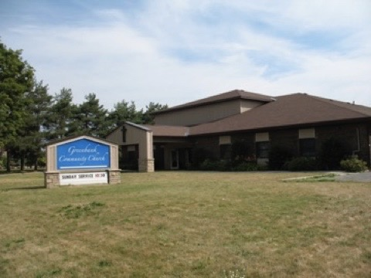
Queensway West Baptist Church Reno 1999
51 Greenbank Rd. 1972

Slide 5
In 1972 Renewal came to Canada through the Suterra brothers. It was a movement of repentance starting with husbands and wives. It touched the whole church. Afterglow sharing followed the evening service. A circle of people prayed, sang and shared for hours. Then in spring 1973 God sent the Jesus’ People to Ottawa. Jim and Candace Finnigan were singing and sharing on Sparks St. They were invited to speak to the QWBC youth group called “The Way People”

Slide 6
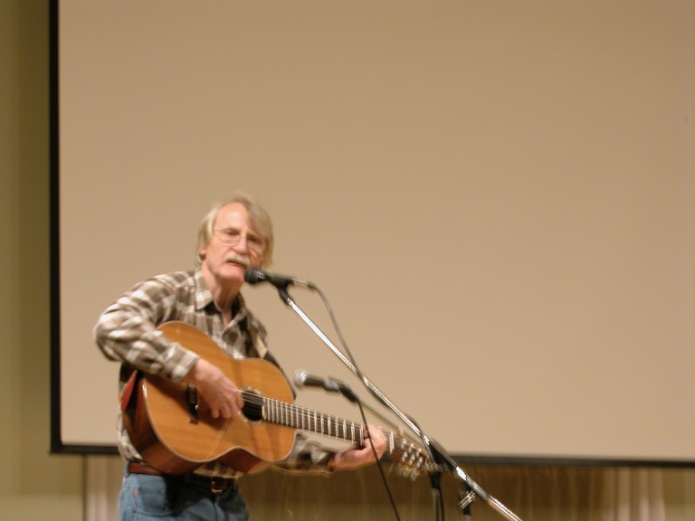
Jim Finnigan 40 years later 2013 (see FB)

Slide 7
Jim and Candace came to speak to the youth at QWBC early summer “72. Many were baptized in the Holy Spirit. One guy came to Christ when he saw it. They took him up to the river and baptized him. The church polarized. In 1973 about half of us left. By August a new church had formed. Again Alan and Catherine Younger, the youth leaders, were the catalysts. The new group invited Lois and me to come to pastor Church of the Way.

Slide 8
We quickly became connected to the Jesus’ People (JP) movement. We promoted outreach concerts in parks and malls. Terry Sheppard, an evangelist from NYC came several times. The first time was to speak at the Baptist church just before the split. Many were impacted by his message. Other JP speakers followed. Terry performed the first marriage in our new community. Our first meeting place was in St. Richard’s Church on Merivale Rd.

Slide 9
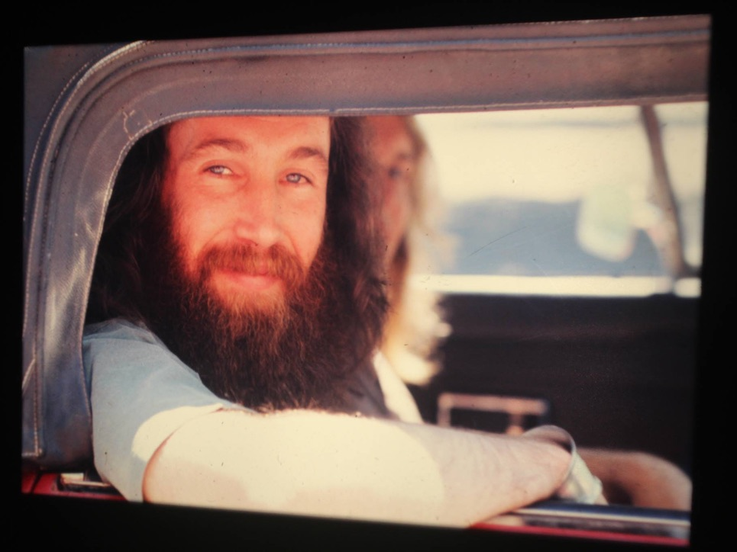
Terry Sheppard 1972

Slide 10
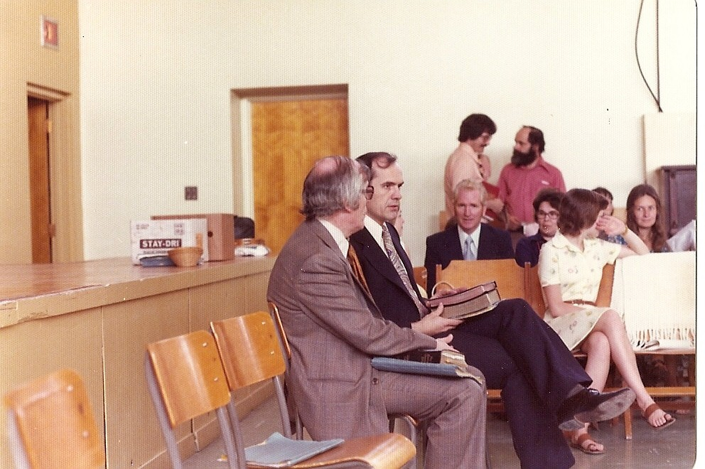
The Beginning: Church of the Way: Alan & Ken

Slide 11
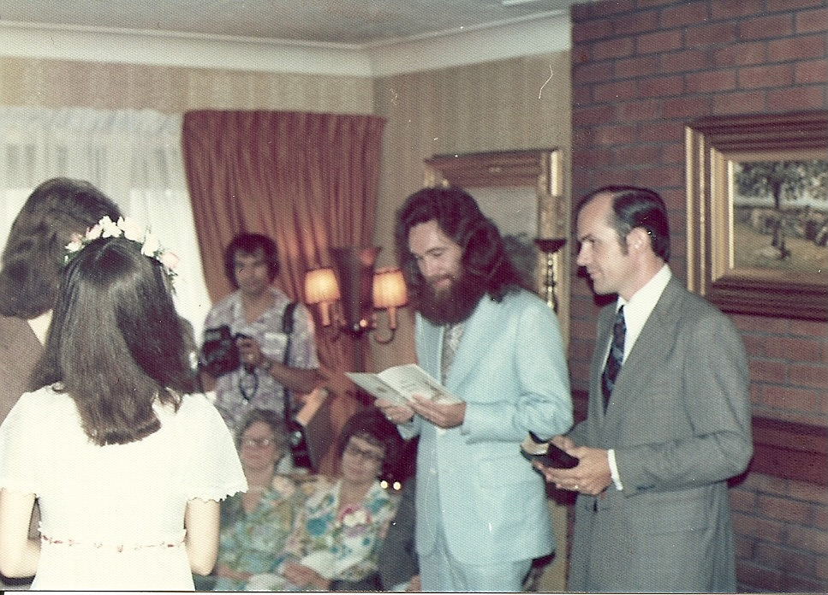
Lloyd & Patricia Younger Terry & Ken
Our first wedding

Slide 12
The Way People continued to meet in Younger’s house on Monday nights. Nelson Richardson’s group met on Friday nights and we did often did outreach together. At this time Bruce Allen made the film “Ordinary People”. Open air baptisms were a feature as well as eating together between services on Sundays.

Slide 13
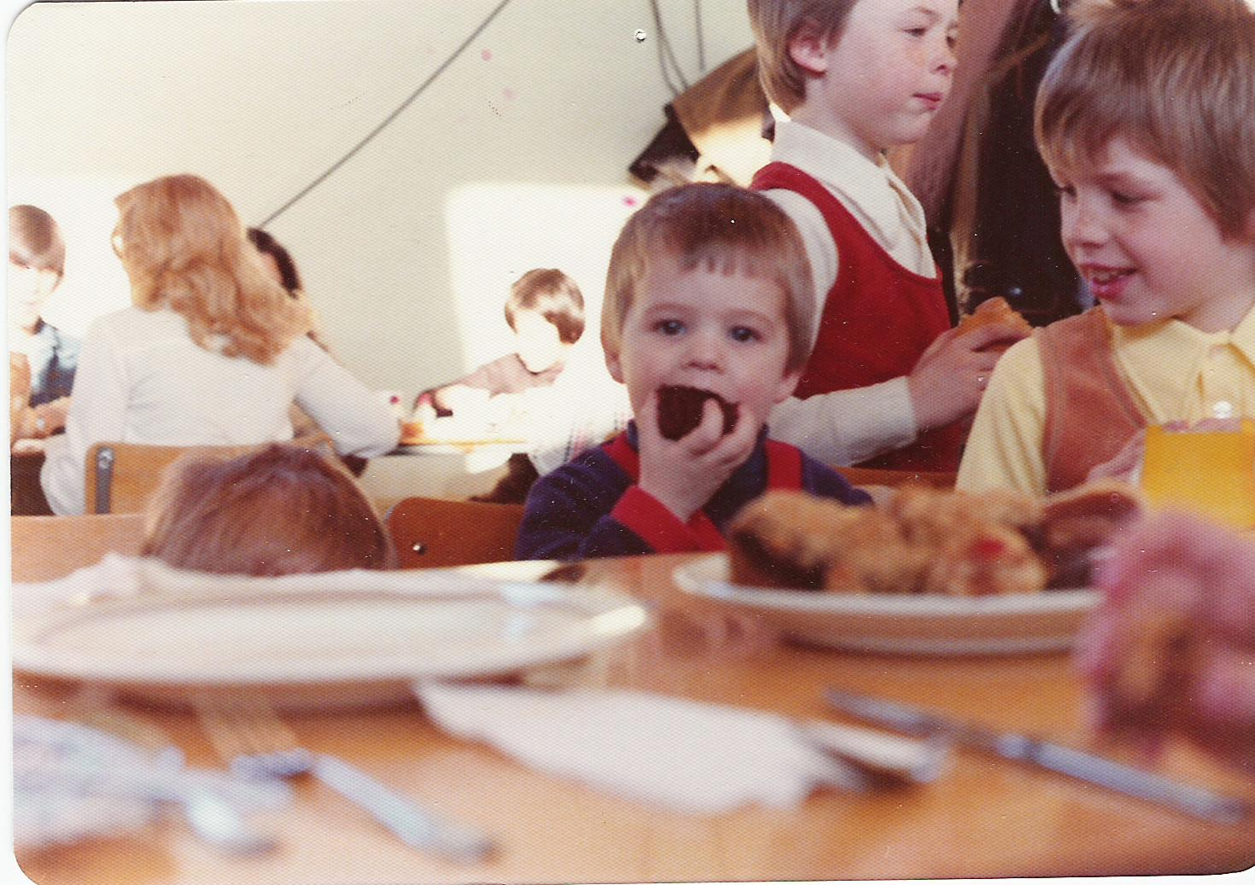

Slide 14
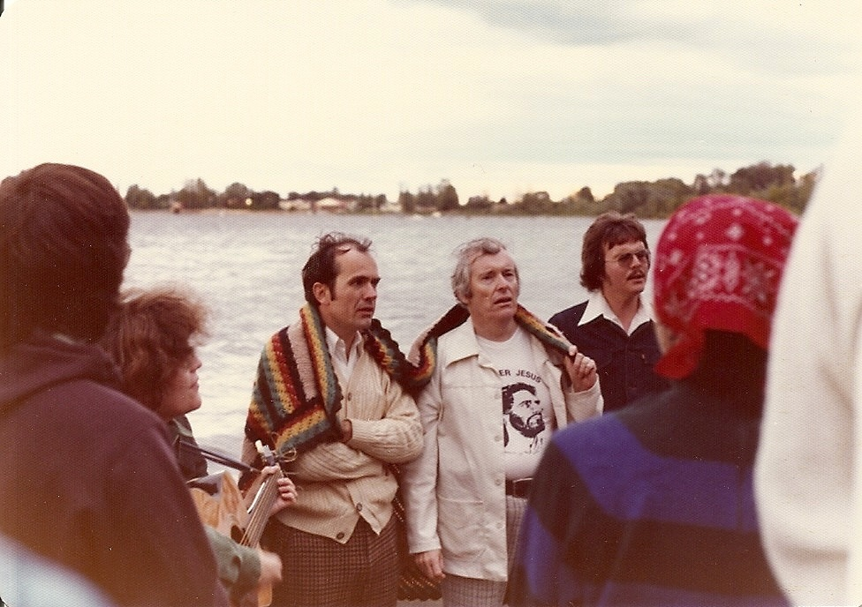
Alan Y speaking after a baptism in Shirley’s Bay.
Jane Y, Ken, Alan, Lloyd

Slide 15
We were a motley group with little common foundation. New Wine Skins are hard to make. We tried a Mennonite consensus model that changed at every meeting. We tried a volunteer leader model that got stuck. Finally we settled on a consensus of elders chosen from the congregation on the basis of gifts and calling and fruit with the counsel of apostolic and prophetic ministries.

Slide 16
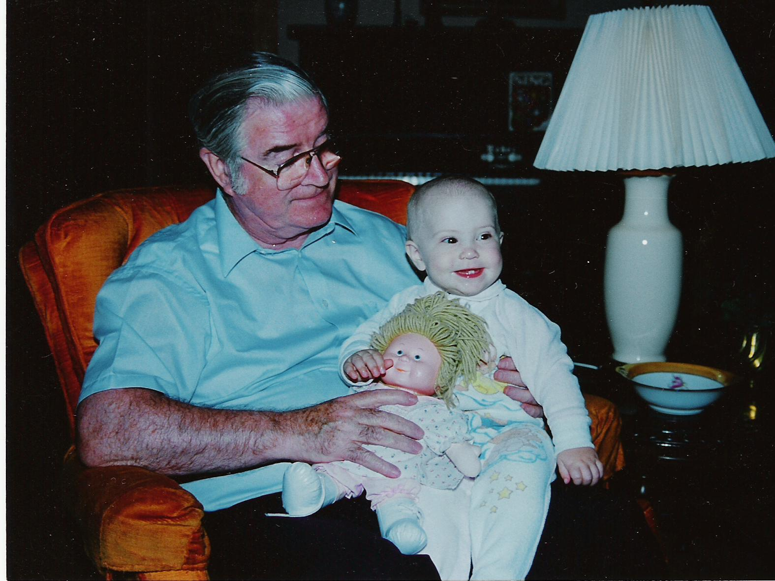
John Hutchison father to WOCC

Slide 17
Eventful ‘80s We tried to do things in community. It’s hard. Younger’s started a wholesale food co-op. Lois and Lois Carruthers started a women’s craft Bible Study that morphed into Salem Books and Gifts after Doug Sprunt and three other families came along; five of us bought a farm together that we called Patmos that we hoped would become a learning centre. We released people to form other congregations of different styles. People left and people came. We wrestled with different apostolic movements. We changed the name of the church to West Ottawa Christian Community in 1981. The wave of Jesus’ People ebbed.

Slide 18
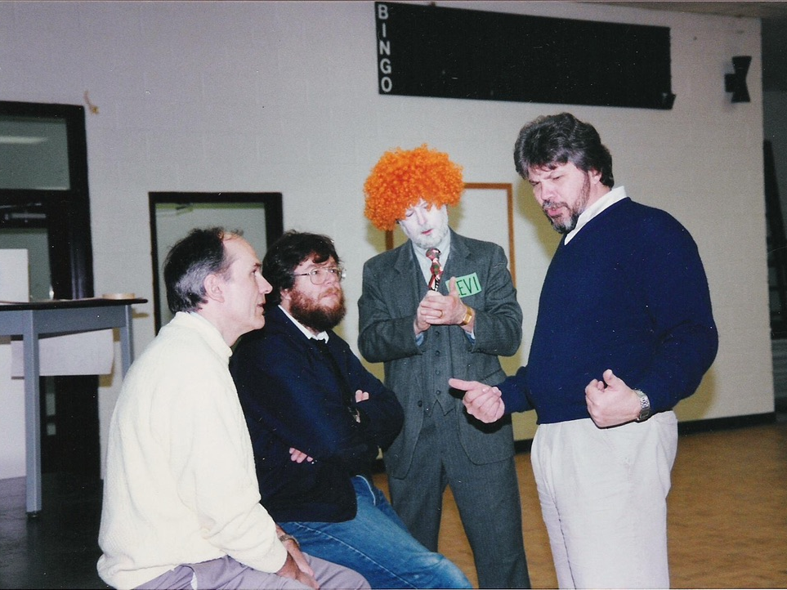
WOCC in the “80s Ken, Terry O, Steve, Owen Carey

Slide 19
Establishing After rejecting two apostolic movements and their authoritarianism we discovered brothers who built on servanthood and a plurality of elders functioning collegially. The connection was providential and not sought. Dale Rumble came to All Saints Lutheran to speak about the New Testament Church. Later his son Don and Owen Carey came into our lives. By example and teaching and coming for a month in January for several years they gave us the foundation that we lacked…Jesus Christ, the functional head of the church.

Slide 20
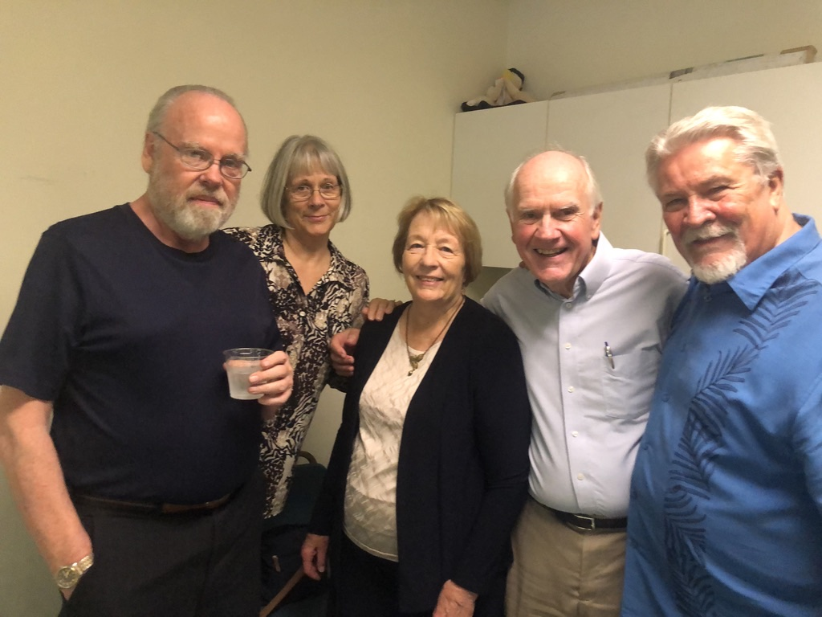
Many years later ’82 to 2022
Don Rumble, Esther Carey, Lois, Ken, Owen Carey

Slide 21
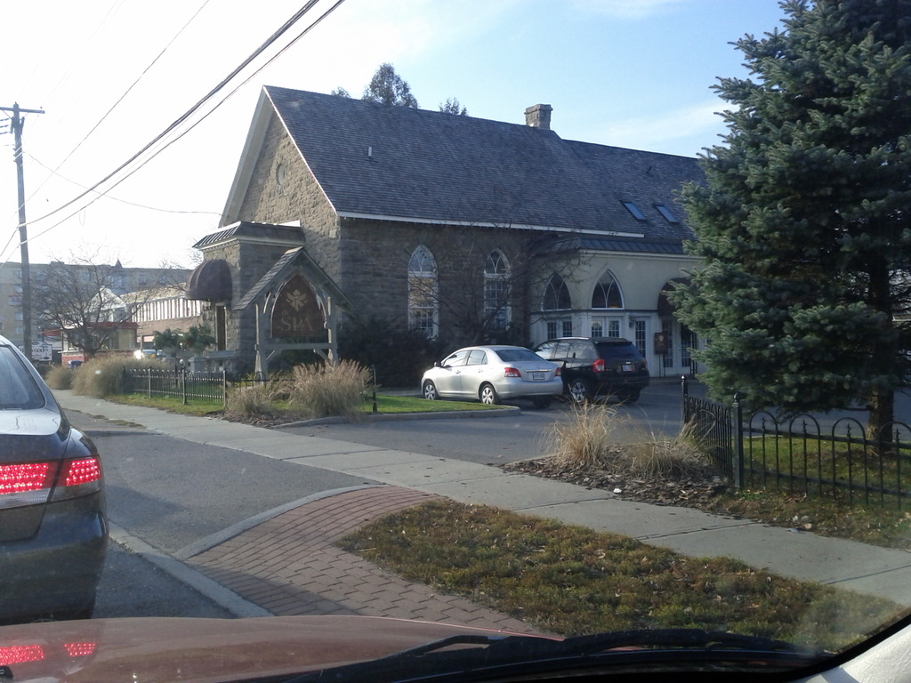
Elim Church Bells Corners

Slide 22
After we had been given the Elim Church in Bells Corners we examined the old papers that came with it. On one of the documents was the name of Dale Rumble. He was a founding member. We discovered a double inheritance; one material and one spiritual.

Slide 23
Missions became a significant part of the ‘90s. Bob and Theresa continued to lead trips to Guatemala and many young people were influenced by the experience. Ken went to Malawi to do a pastors’ conference. Then Doug Sprunt had a dream through which we reacquired 1311 Pinecrest Rd. We renovated it for church offices and meetings while we met in Pinecrest P./S. We used funds from the sale of the old church in Bell’s Corners for missions projects and then for 1311 Pinecrest Rd. During this time we also helped other congregations to start up. Many of us became involved with Shiloh Hills and our Jewish Roots. Bob and Teresa carried this forward. In 1993 Ken and Lois went to TACF for a prophetic conference. They booked Marc Dupont to come to WOCC in Feb. 1994. Before he came renewal had broken out there and here. WOCC carried the renewal in Ottawa and the Valley for months. When Catch the Fire started their first church in the city we blessed many of our people to join them.

Slide 24
In 1995 we became involved with Watchmen for the Nations because of our previous
friendship with Pastor Bob Birch. He was a leader in the prayer movement in Canada, a pastor in Vancouver who welcomed the Jesus’ People and a founder of Watchmen for the Nations.
He offered to come to WOCC because of mutual friends.
He mentored David Demian and they frequently visited the Valley and spoke at Shiloh Hills, near Renfrew where WOCC people were faithful supporters.
It became a source for many people discovering the Jewish Roots of the church. His life there was John 17; his guiding principle was “hear what the Spirit is saying to the church”.

Slide 25
Pastor Bob Birch

Slide 26
In the late ‘80s WOCC took over the leadership of March for Jesus. It covered the time of the Billy Graham Mission in Ottawa. As usual, it involved everyone including our dancers.

Slide 27
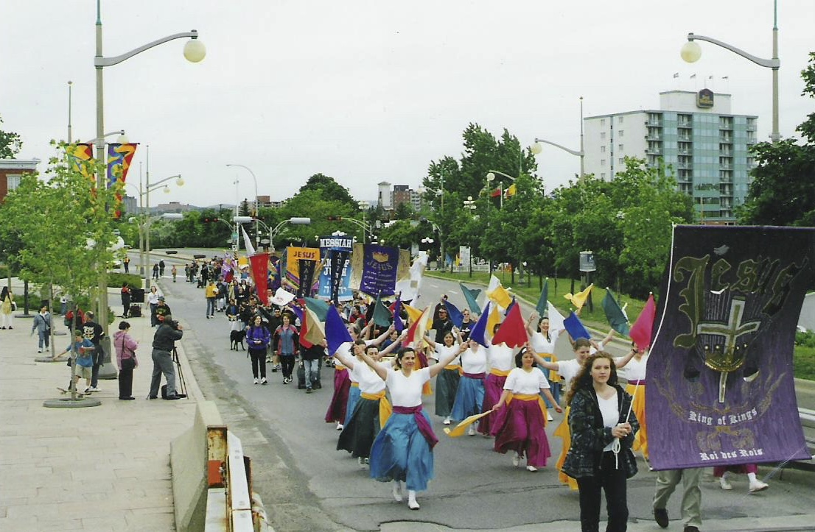

Slide 28
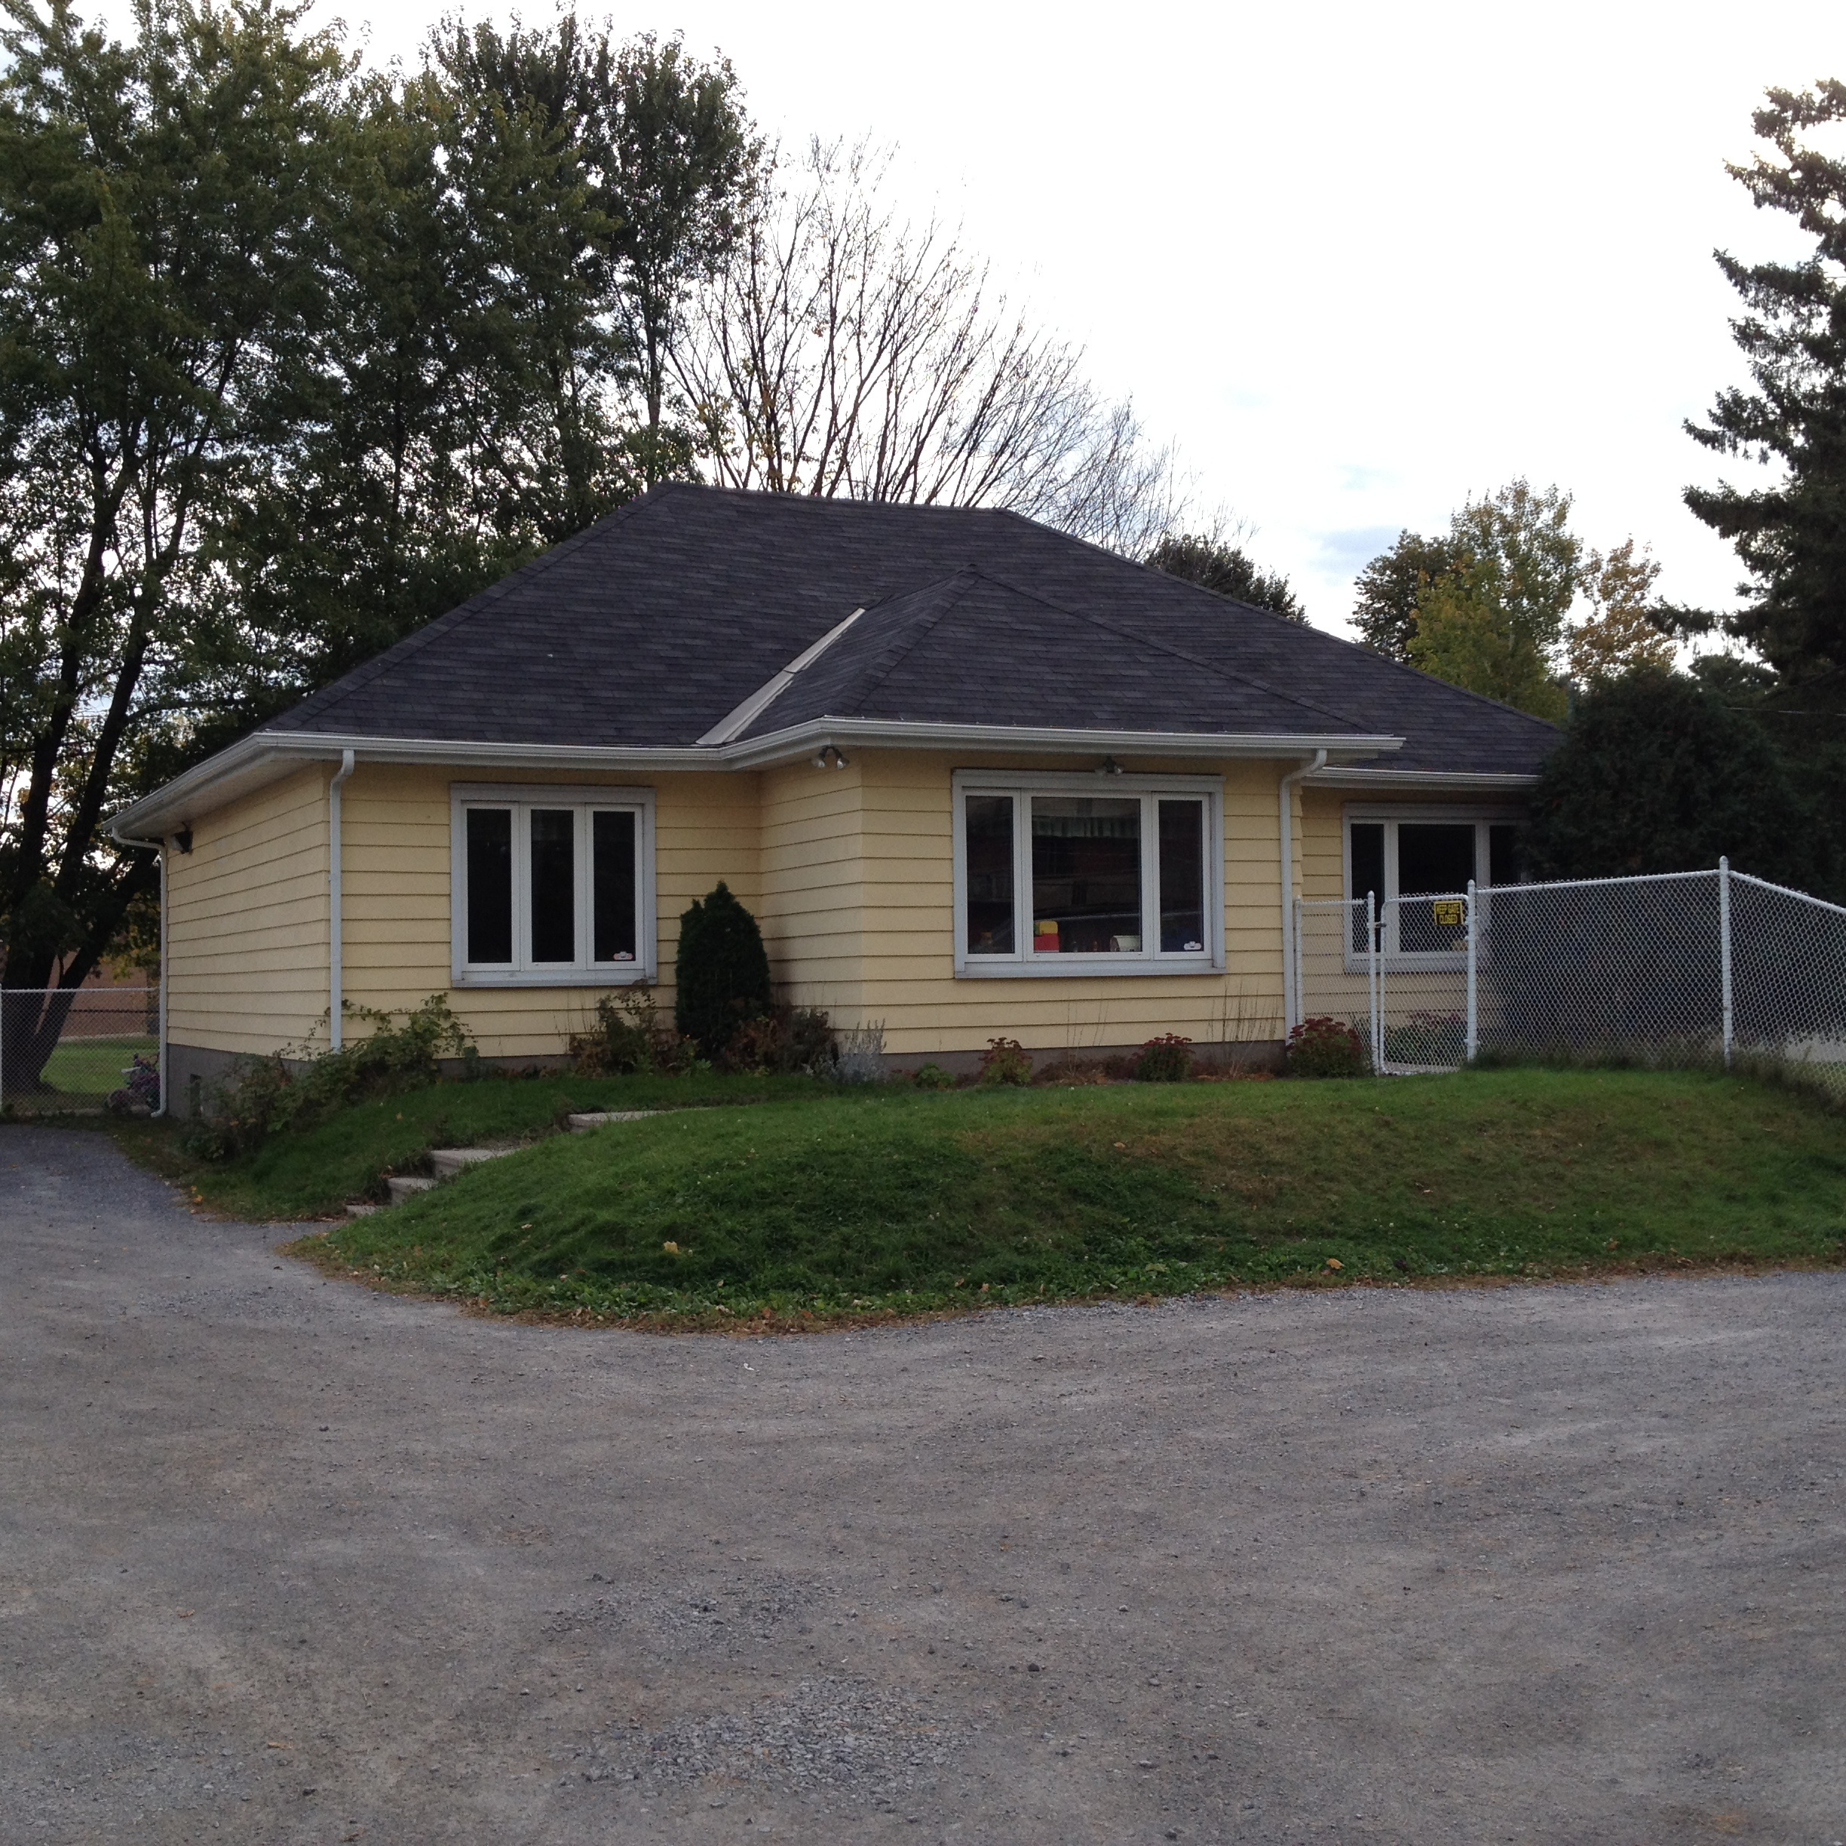
1311 Pinecrest Rd. 1990
Ken Hall March 26,2023

Slide 29
Into 2000’s After our experience of renewal in 1994 we recognized our need of permanent facilities. In 2000 this building was brought to our attention. With many challenges we bought it, renovated it with our own labour and moved into it in 2001.

Slide 30
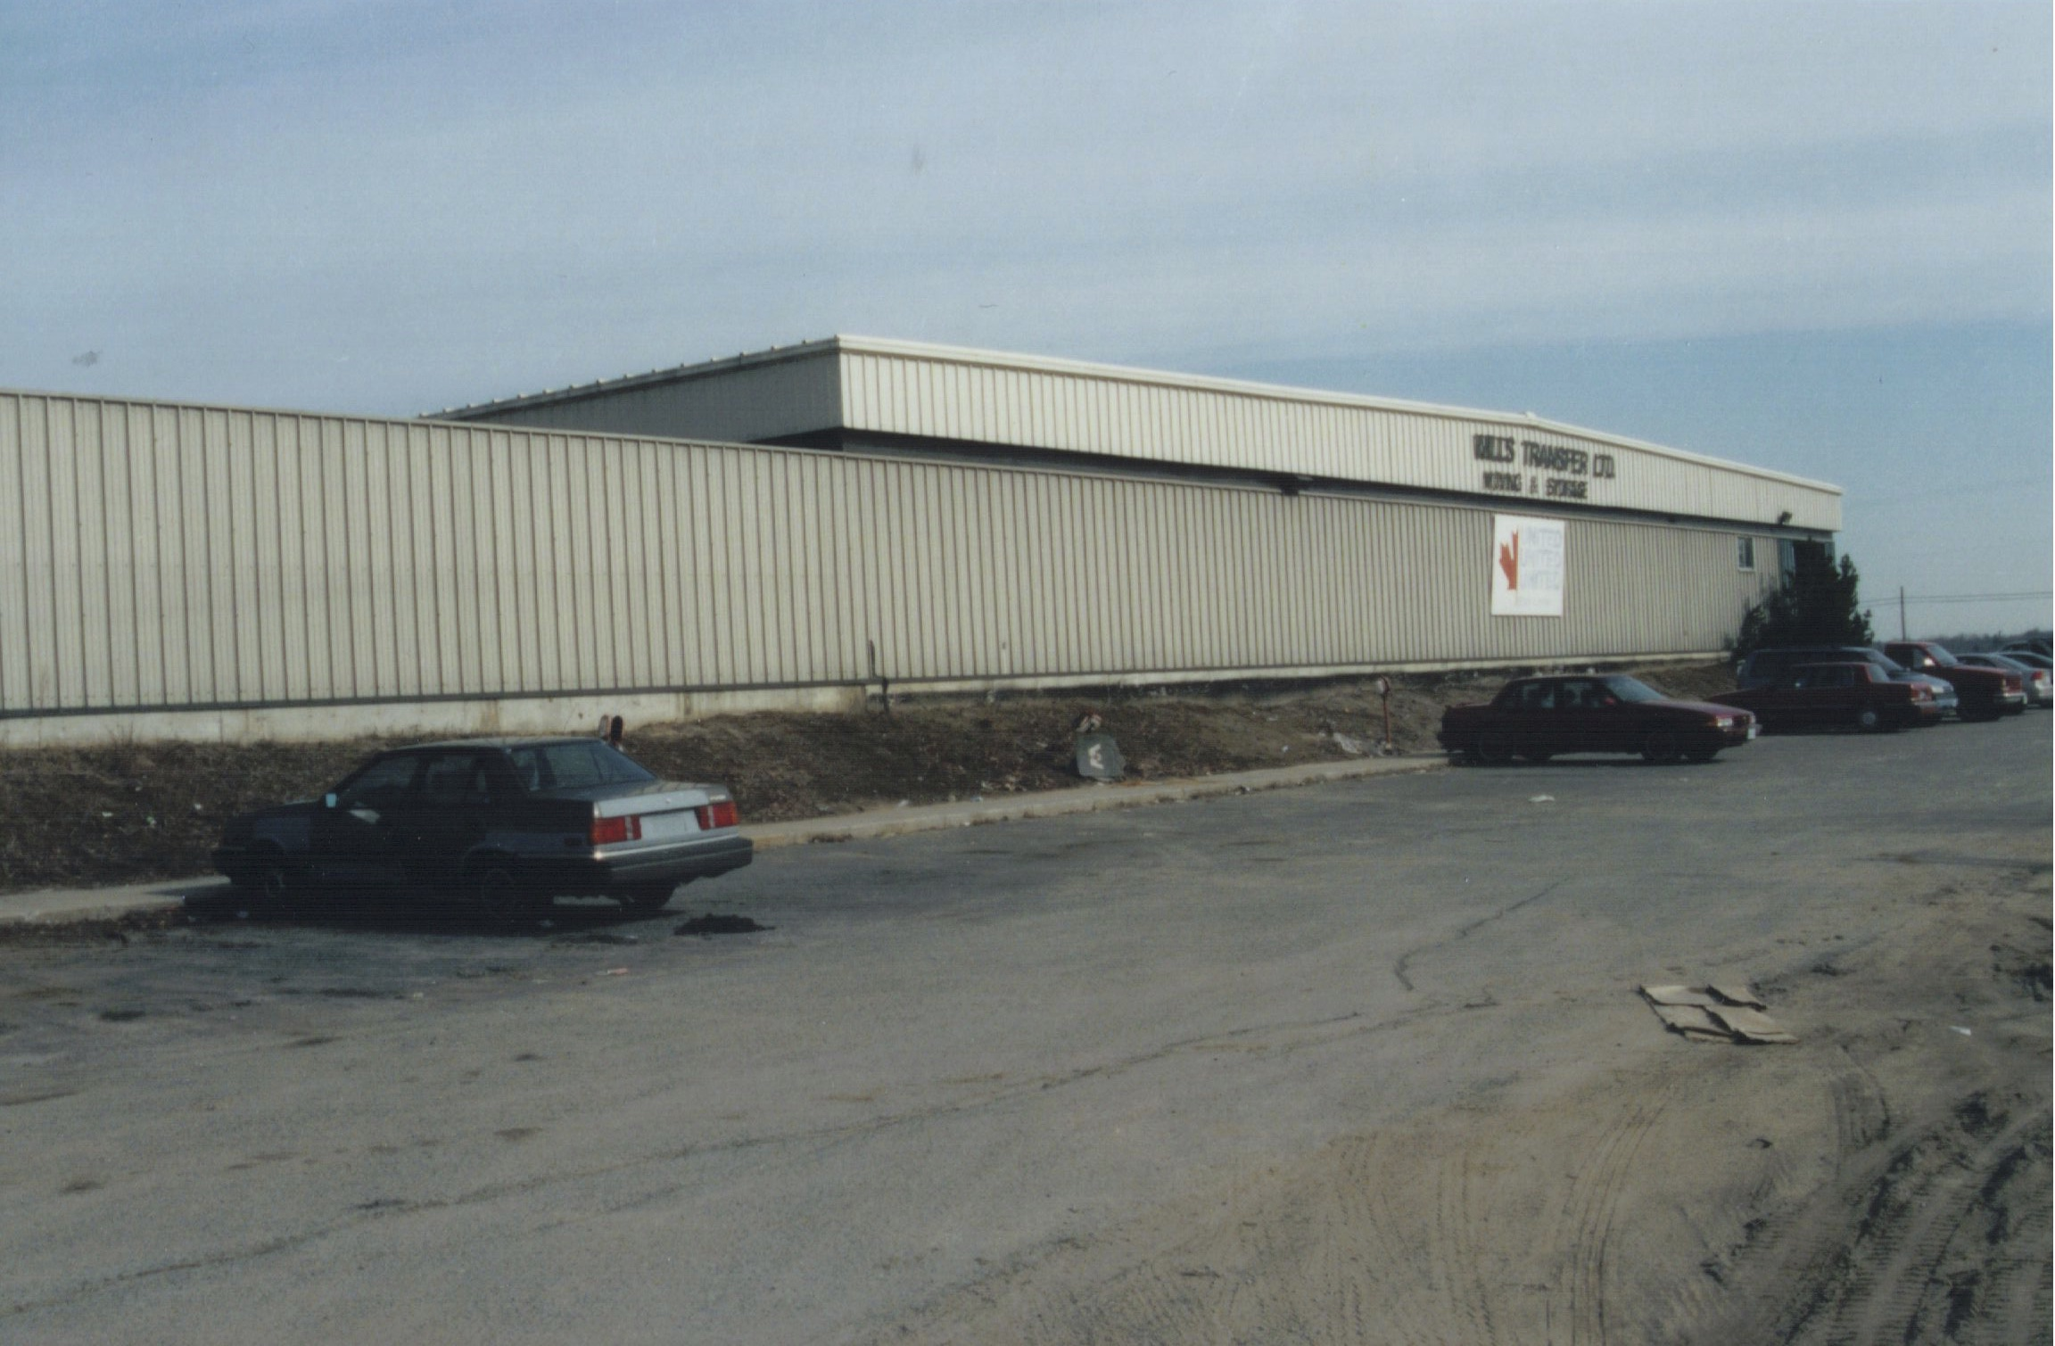

Slide 31
WOCC & Greenbank Churches In 2005 Queensway West Baptist Church became Greenbank Church and embraced the gifts and ministries of the Holy Spirit. In 2006 they sought reconciliation with those of us who had been dismissed in 1973 and blessed us as our parent church. 2011 marked Greenbank’s 50th. Ken & Lois returned to GCC as interim in 2012. In 2013 WOCC celebrated its 40th Anniversary joined by Greenbank. Greenbank morphed into Ottawa Vineyard in 2016 and is prospering.

Slide 32
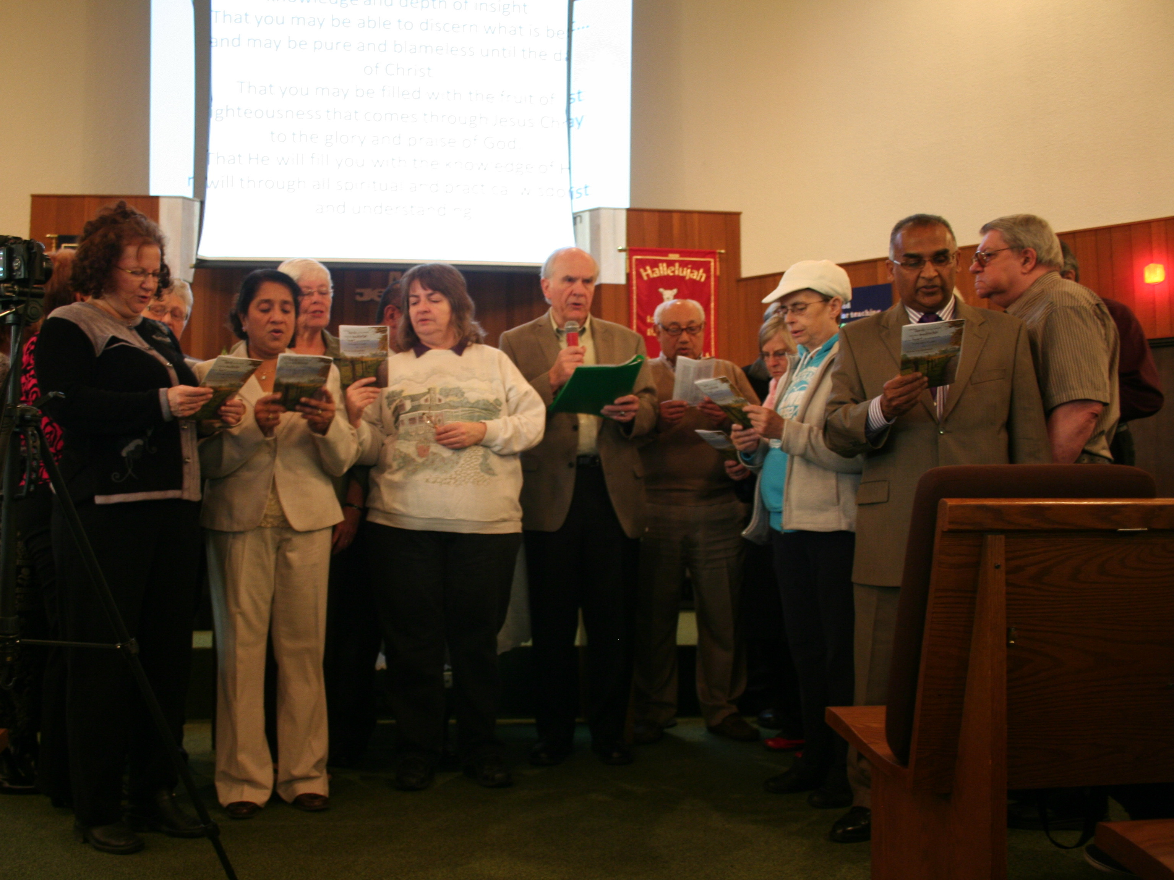
Celebration of Reconciliation between Queensway West/Greenbank Church and West Ottawa CC. Nov. 2016

